Slide 1
MS-Project
Mid-market leader
Has approx. 50% overall market share
70-80% MS-Project users never used automated project tracking prior (a “first” tool)
Not a mid/high-end tool for EPM (Enterprise Project Mgmt.)

Slide 2
Project Pros
Easy outlining of tasks
Resource management
Accuracy: baseline vs. actual; various calculations
Easy charting and graphics
Cost management
Capture historical data

Slide 3
Project Cons
Illusion of control
Workgroup features ok, still in-progress
Scaling
No estimation features
Remember:
  Being a MS-Project expert does not make you an expert project manager!
  No more so than knowing MS-Word makes you a good writer.

Slide 4
The MS-Project Process
Move WBS into a Project outline (in Task Sheet)
Add resources (team members or roles)
Add costs for resources
Assign resources to tasks
Establish dependencies
Refine and optimize
Create baseline
Track progress (enter actuals, etc.)

Slide 5
Project Overview
This is a ‘quickie’ overview
We will return to all of these steps individually over the next few weeks
Sample project from McConnell

Slide 6
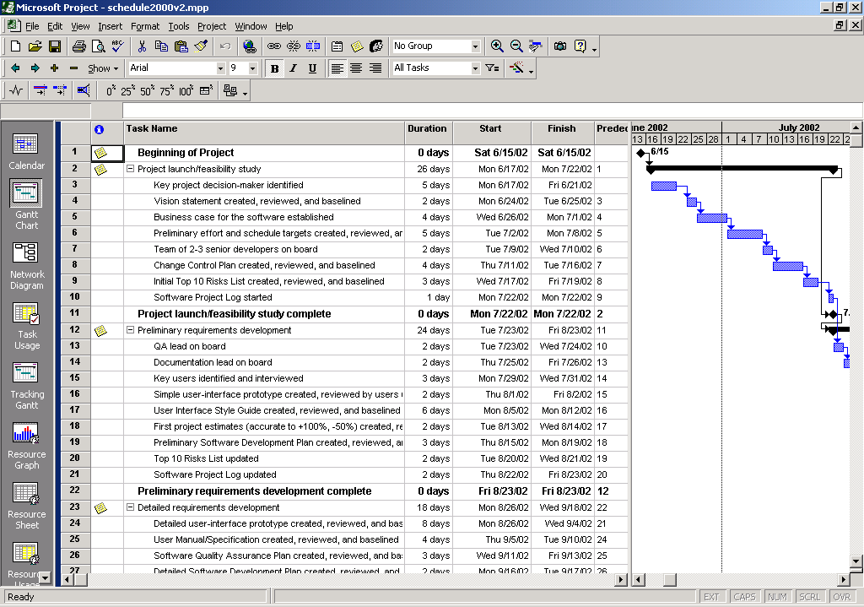
Project UI
Views
  Default is Gant Chart View
    2 panes
    Task Sheet on left (a table)
    Gantt Chart on right
  View Bar on far left

Slide 7
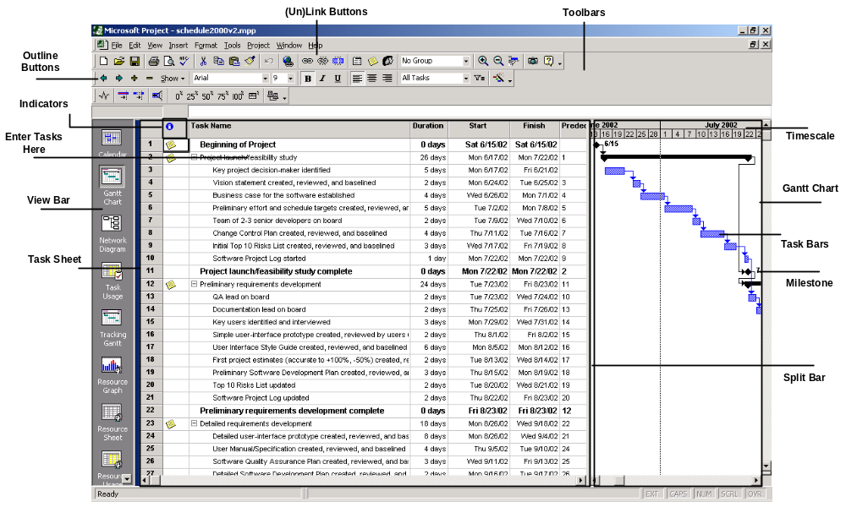
Project UI

Slide 8
Create Your Project
File/New
Setup start date
Setup calendar
  Menu: Project/Project Information
  Often left with default settings
  Hours, holidays

Slide 9
Enter WBS
Outlining
Sub-tasks and summary tasks
Do not enter start/end dates for each
Just start with Task Name and Duration for each
Use Indent/Outdent buttons to define summary tasks and subtasks
You can enter specific Start/End dates but don’t most of the time

Slide 10
Establish Durations
Know the abbreviations
  h/d/w/m
  D is default
Can use partial
  .5d is a half-day task
Elapsed durations
Estimated durations
  Put a ‘?’ after duration

Slide 11
Add Resources
Work Resources
  People
Material Resources
  Things
  Can be used to track costs
    Ex: amount of equipment purshased
  Not used as often in typical software project

Slide 12
Resource Sheet
Can add new resources here
  Or directly in the task entry sheet
    Beware of mis-spellings (Project will create near-duplicates)
Setup costs
  Such as annual salary (put ‘yr’ after ‘Std. Rate’)

Slide 13
Effort-Driven Scheduling
MS-Project default
Duration * Units = Work
    Duration = Work / Units (D = W/U)
    Work = Duration * Units (W = D*U)
    Units = Work / Duration (U = W/D)
Adding more resources to a task shortens duration
Can be changed on a per-task basis
    In the advanced tab of Task Information dialog box
    Task Type setting
Beware the Mythical Man-month
    Good for laying bricks, not always so for software development

Slide 14
Link Tasks
On toolbar: Link & Unlink buttons
  Good for many at once
Or via Gantt chart
  Drag from one task to another

Slide 15
Milestones
Zero duration tasks
Insert task ‘normally’ but put 0 in duration

Slide 16
Make Assignments
Approach 1. Using Task Sheet
  Using Resource Names column
  You can create new ones by just typing-in here
2. Using Assign Resources dialog box
  Good for multiple resources
  Highlight task, Tools/Resources or toolbar button
3. Using Task Information dialog
  Resources tab
4. Task Entry view
  View/More Views/Task Entry
  Or Task Entry view on Resource Mgmt. toolbar

Slide 17
Save Baseline
Saves all current information about your project
  Dates, resource assignments, durations, costs

Slide 18
Fine Tune
Then is used later as basis for comparing against “actuals”
Menu: Tools/Tracking/Save Baseline

Slide 19
Project 2002
3 Editions: Standard, Professional, Server
MS Project Server 2002
    Upgrade of old “Project Central”
    Includes “Project Web Access”, web-based UI (partial)
    Workgroup and resource notification features
    Requires SQL-Server and IIS
    “Portfolio Analyzer”
      Drill-down into projects via pivot tables & charts
    “Portfolio Modeler”
      Create models and “what-if” scenarios
    SharePoint Team Services integration

Slide 20
Project 2002
MS-Project Professional
  “Build Team” feature
    Skills-based resource matching
  Resource Pools: with skill set tracking
  Resource Substitution Wizard
“Project Guide” feature
  Customizable “process component”

